Slide 1
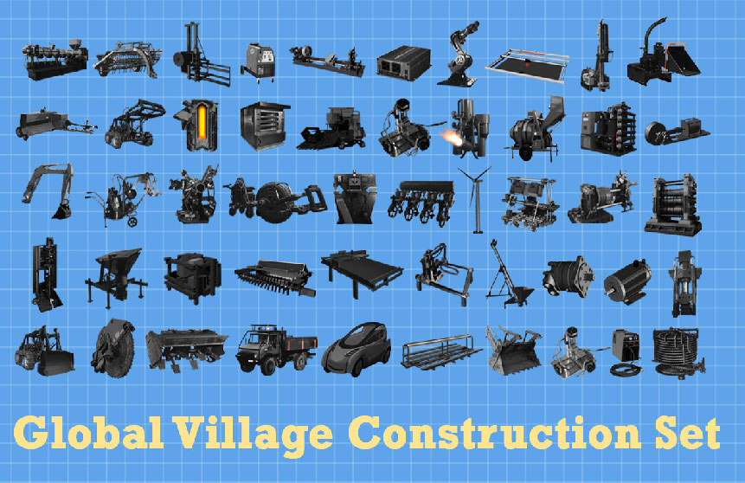
Open Hardware
Sanli Faez
Department of Physics @sanli

Slide 2
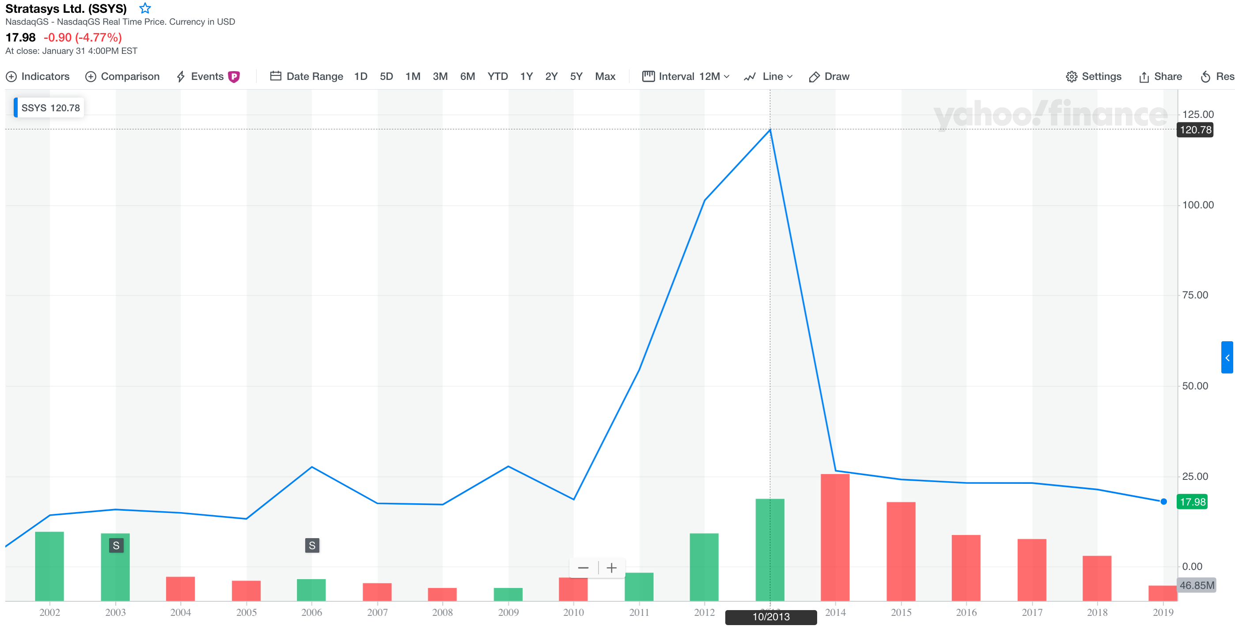
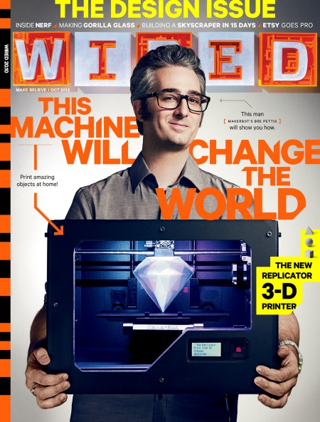
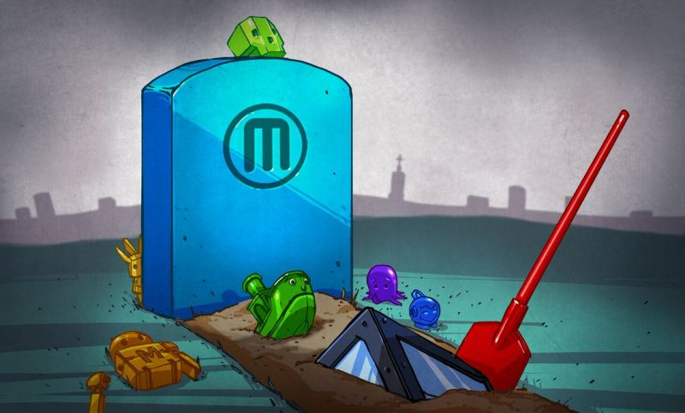
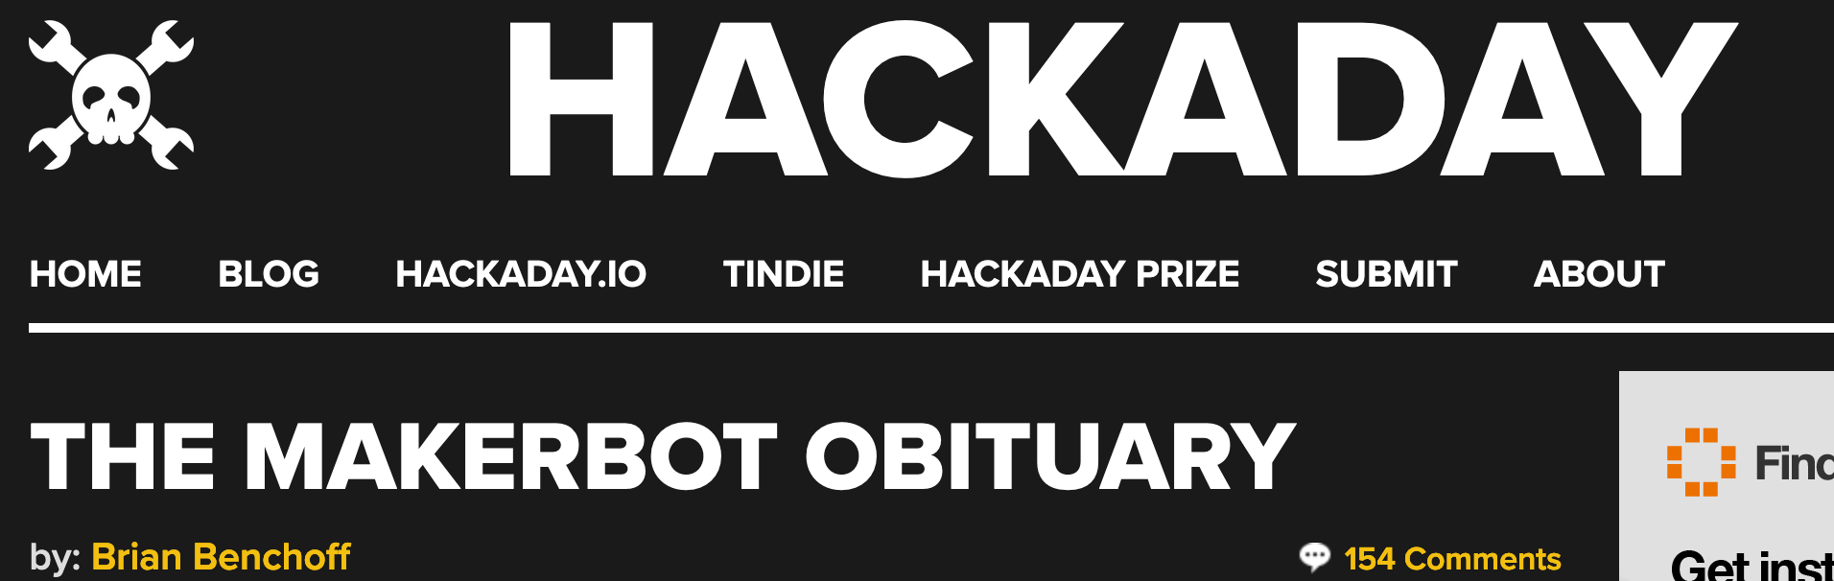
paid $403 Million for Makerbot

Slide 3

IN 2019 the total value of 3D printed parts increased by 3-folds. Over 550,000 parts were 3D printed in 3D Hubs' ecosystem alone.

Slide 4
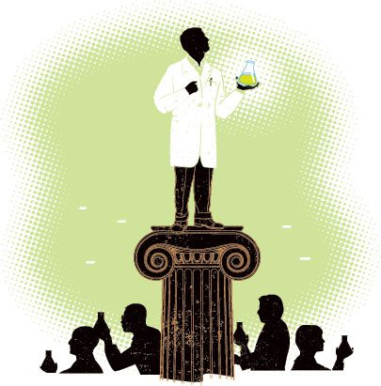

(just like open science) Open Hardware is About the Community
Egocentric
Networked

Slide 5
Ulrich Gerndt | change factory GmbH

Slide 6
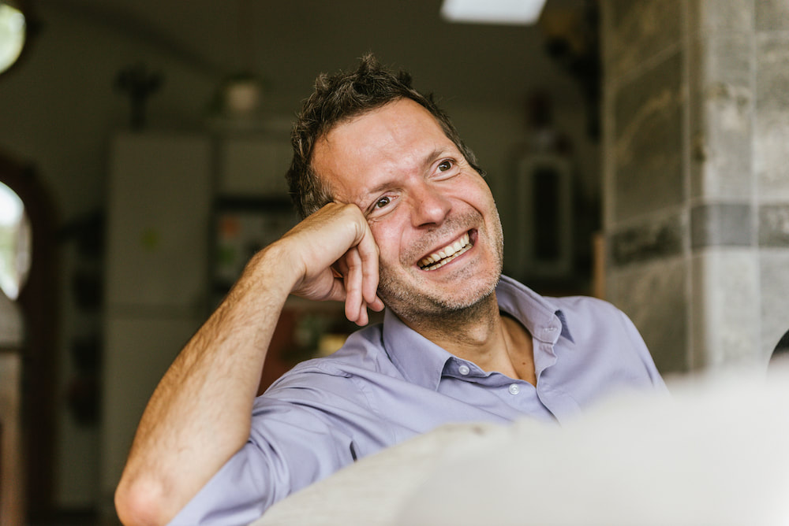
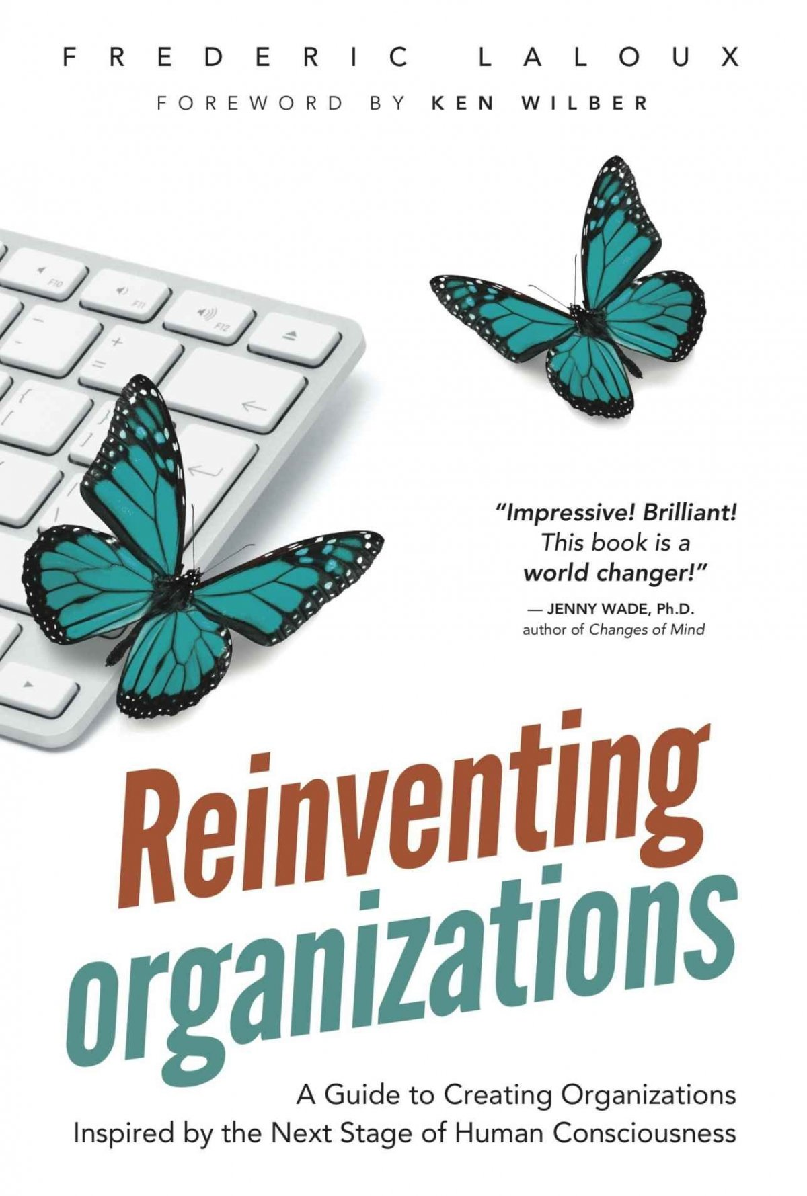
Consciously or unconsciously, leaders put in place organizational structures, practices, and cultures that make sense to them, that correspond to their way of dealing with the world.
The general rule seems to be that the level of consciousness of an organization cannot exceed the level of consciousness of its leader.
Photo credit: Freunde von Freunden - Robert Rieger
https://www.reinventingorganizations.com/

Slide 7
7 suggestions
& some examples

Slide 8
0. Open source ≠ free labor
Open Source by the Numbers, Rich Sands, Black Duck Software Inc. (data from 2012)

Slide 9
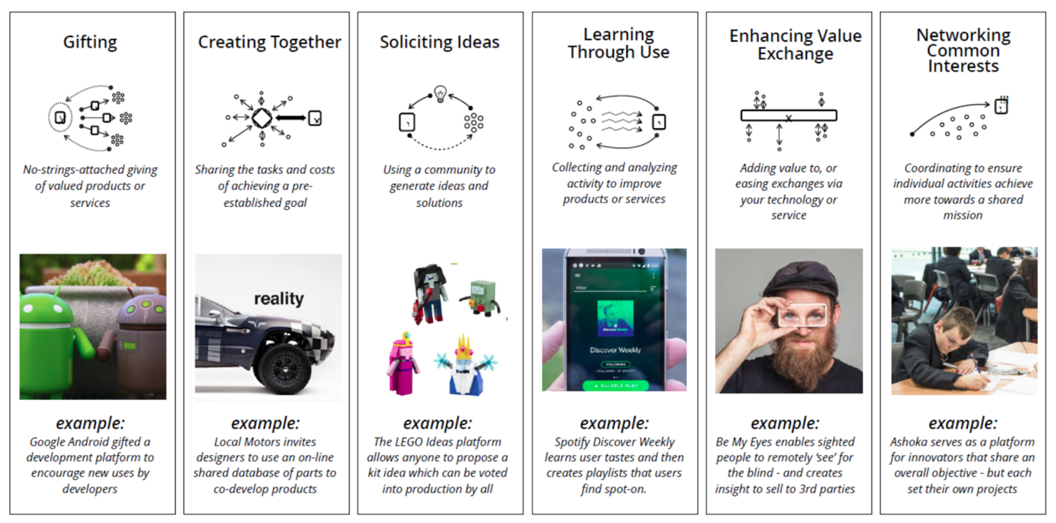
1. Understand community interactions
A Framework of Open Practices, Alex Klepel, Communications Lead, Mozilla Open Innovation

Slide 10
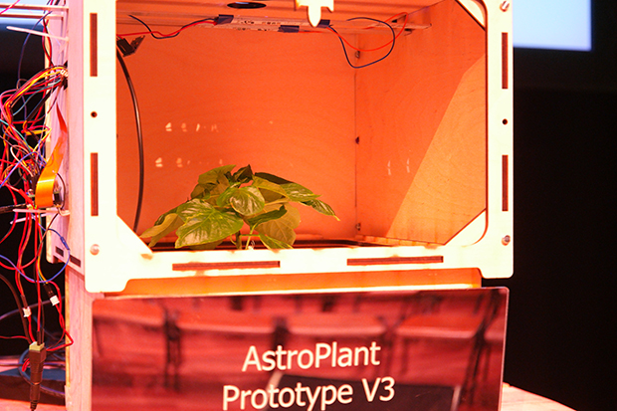
1. Understand community interactions
Agency/empowerment
Altruism
Coaching
Compensation
Delegation/promotion
Early access
Free/discounted access
Feedback
In-kind contributions
Introductions/networking
Membership/freemium models
Mentorship
On-boarding
Pay it forward
Professional advice
Professional development
Public acknowledgement/recognition
Reach
Reputation/social capital
Resourcing
Special consideration/opportunities
Storytelling
Swag
https://www.astroplant.io/
Taxonomy of open value exchanges, Mozilla Open Leadership Framework

Slide 11

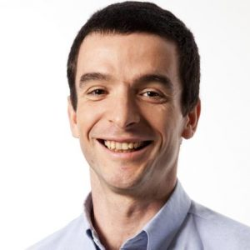
2. Have an admirable grand vision
Marcin Jakubowski, Ph.D.
TED 2011 – Open-sourced Blueprints for Civilization
www.opensourceecology.org

Slide 12
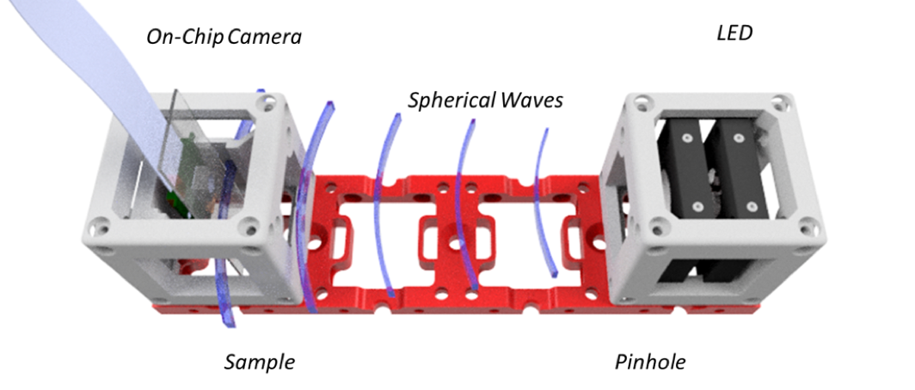
3. Avoid the tyranny of structurelessness
Jo Freeman’s PRINCIPLES OF DEMOCRATIC STRUCTURING
Delegation
Responsibilities
Distribution
Rotation
Allocation
Diffusion of information
Equal access to resources
www.useetoo.org
www.jofreeman.com/joreen/tyranny.htm

Slide 13
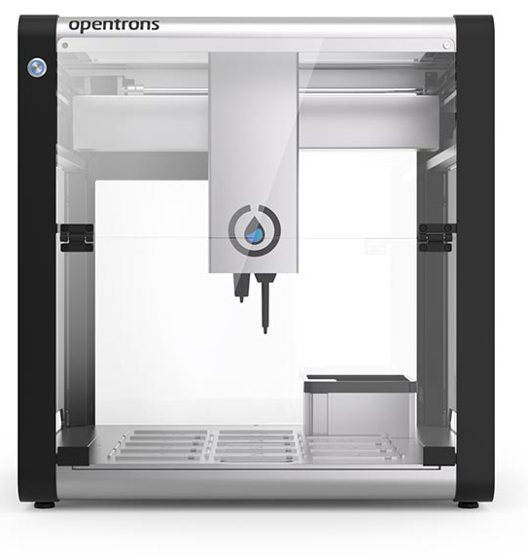

4. Choose an altruistic team
“Selfishness beats altruism within groups.
Altruistic groups beat selfish groups. Everything else is commentary”
www.opentrons.com
Does Altruism Exist? Culture, Genes, and the Welfare of Others, by David Sloan Wilson, Yale UP, 2015

Slide 14
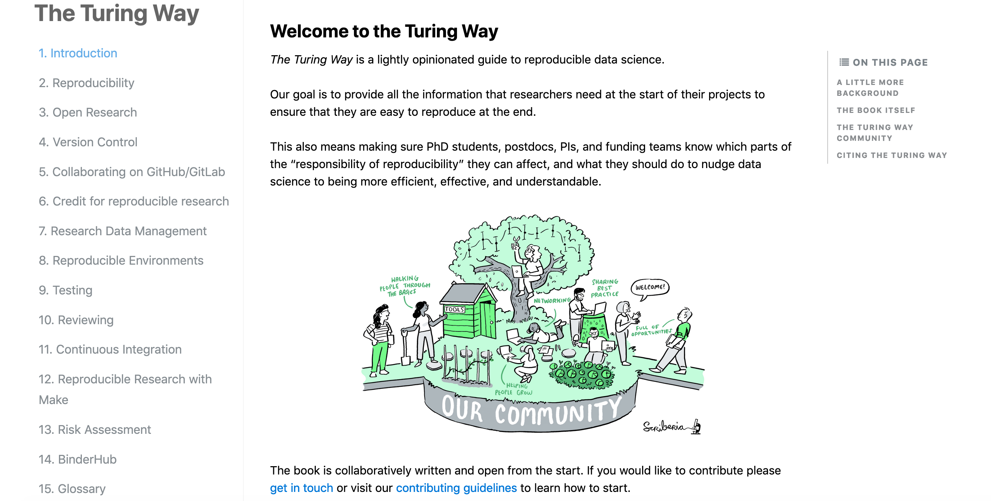
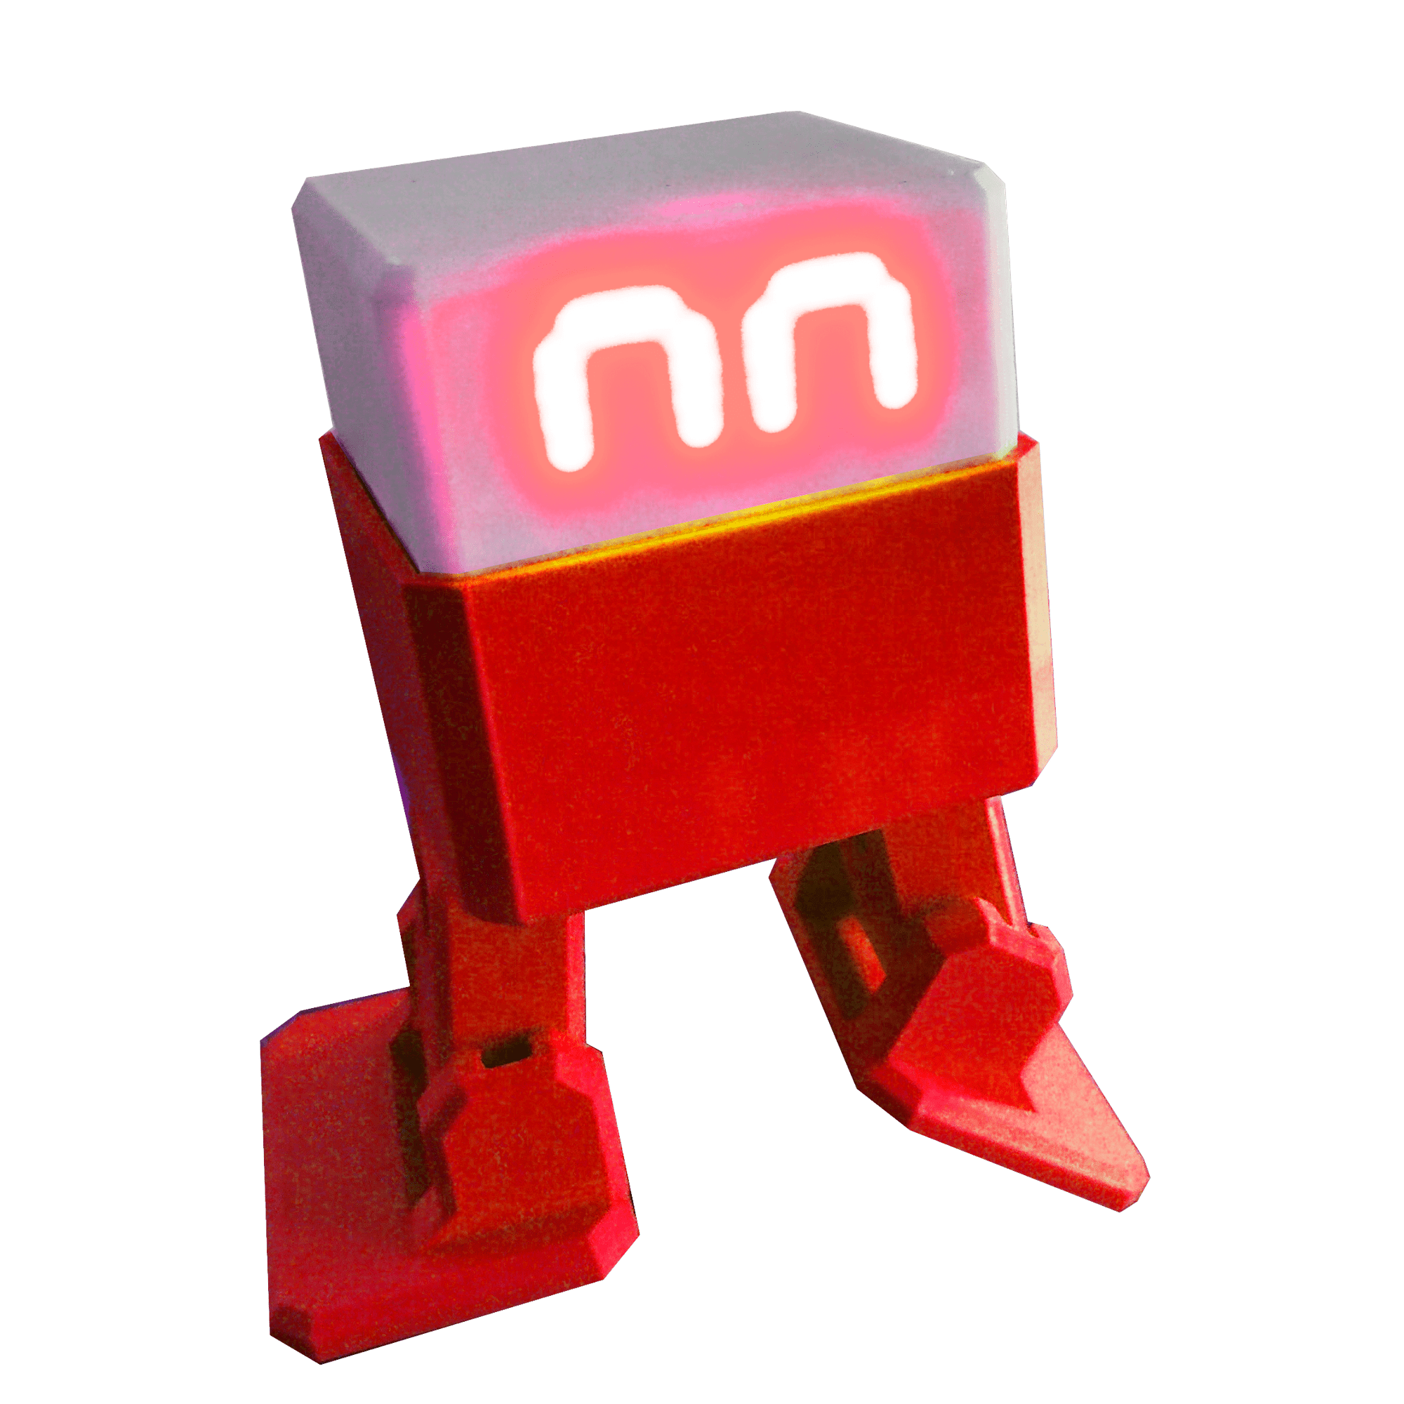
5. You don’t have to start from scratch
the-turing-way.netlify.com/
www.ottodiy.com

Slide 15
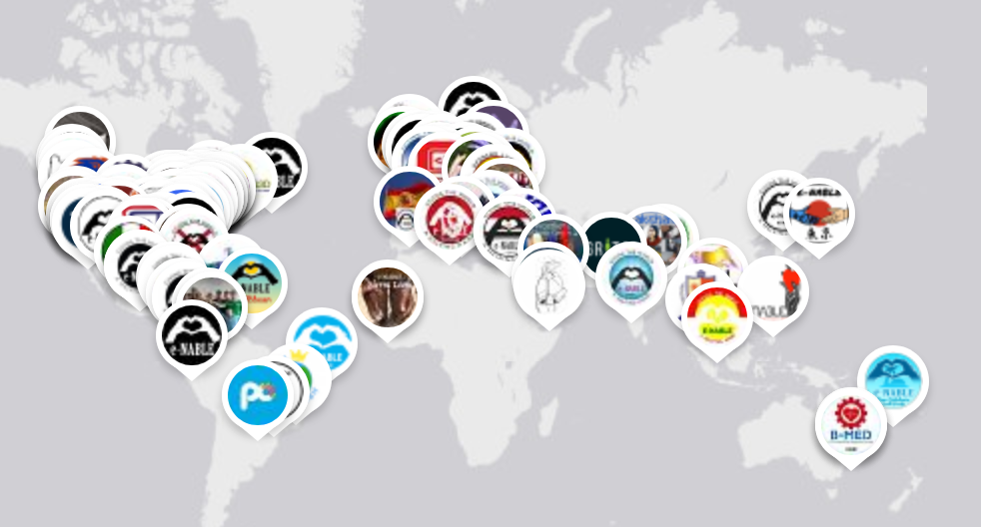
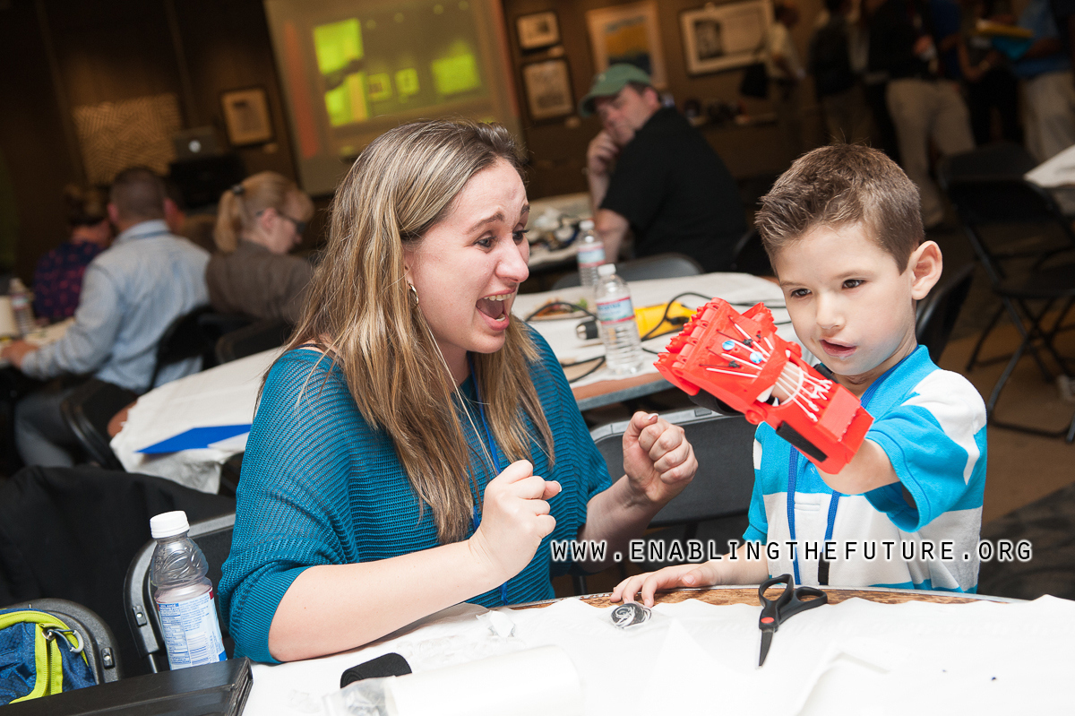
6. Get in touch with users at an early stage
www.enablingthefuture.org

Slide 16
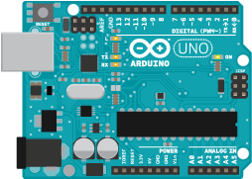



7. Choose a good motto
So easy,
my granny
can use it
people above projects, projects above people’s stuff
Sharing knowledge to build rich, sustainable lives.
Community over Code
healthy community is a higher priority than good code
https://www.appropedia.org/

Slide 17
7 suggestions
Understand community interactions
Have an admirable grand vision
Avoid the tyranny of structurelessness
Choose and altruistic team
You don’t have to start from scratch
Get in touch with users at an early stage
Choose a good motto

